Slide 1
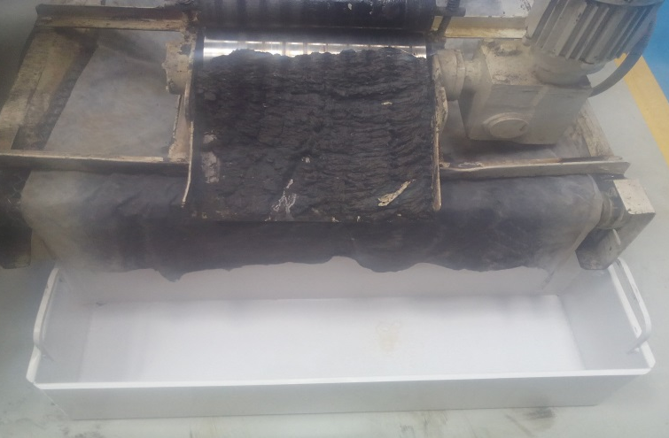
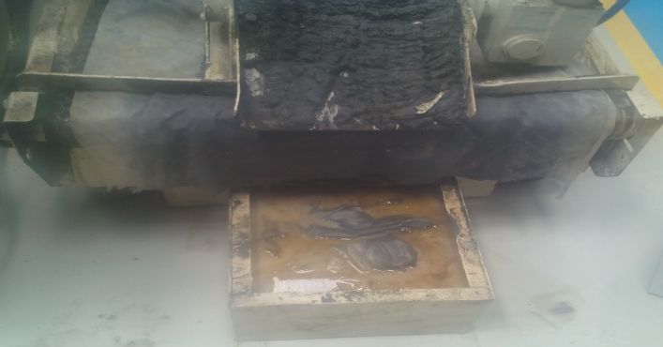
P15
KAIZEN NO :- 12
ACTIVITY
KK
QM
PM
JH
SHE
OT
DM
E&T
KAIZEN IDEA SHEET
TPM CIRCLE NAME:
LOSS NO. / STEP
DEPT :- MACHINE SHOP
RESULT AREA
P
Q
A,B,C
C
D
S
M
CELL:- Grinding
CELL NAME:- A225 Gear
MACHINE / STAGE :- Microsmatic Grinding
OPERATION :- O.D Grinding.
KAIZEN THEME : To reduce cleaning time in JH at A225 Gear Grinding operation.
IDEA :- Big tray.
Problem / Present Status :-
Heavy coolant spillage at A225 Gear grinding machine causes cleaning time 10 minutes / shift
COUNTERMEASURE:- Tank size modified as per the Requirement.
BENCHMARK
Slush on Floor
TARGET
Floor should be clean
KAIZEN START
18.04.2016
TDC
29.04.2016
KAIZEN FINISH
TEAM MEMBERS : 1. Dinesh Kakad
2. Sandip Jagtap
BENEFITS :-
1. Machine availability increased by 10 min / shift.
2. 1S & 2S score improved.
After
KAIZEN SUSTENANCE
WHY - WHY ANALYSIS :-
Why1 :- Cleaning time required 10 minutes.
Why2:- Heavy sludge spillage near dust separator.
Why3:- Dust collecting tray is of small size.
Why4 :- Basic design of Sludge tray is Small.
RESULT :-
Grinding Slush spillage Avoided.
House Keeping Improve.
WHAT TO DO:- Use only Modified Tank
HOW TO DO:- N.A
ROOT CAUSE :- Small tray.
REGISTRATION NO. & DATE : 29.04.2016
SCOPE & PLAN FOR HORIZONTAL DEPLOYMENT
REGISTERED BY :- Sandip Jagtap
SR.
NO.
CELL
TARGET
RESPONSIBILITY
STATUS
MANAGER’S SIGN :- D. Y. Pawar
1
---
------
-----
----

